Slide 1
Git Basics
A Modern Version Control System
Notes:
Version control systems are a category of software tools that help a software team manage changes to source code over time.
Track every modification
Concurrent working from conflicting

Slide 2
Outline
What is Git?
Why should we learn Git?
How to get start?

Slide 3

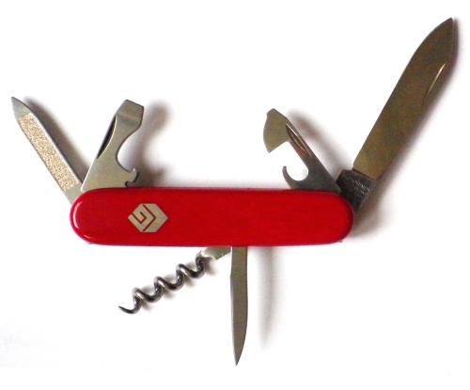


40 Years of version control
Subversion (2001)
SCCS & RCS (1970s)
Git (2005)
Image © TheSun.au
CVS (1986)
Notes:
SCCS: source code control system
RCS: revision control system
CVS: concurrent version system
Rather than have only one single place for the full version history of the software, every developer’s working copy of the code is also a repository that can contain full history of all changes.

Slide 4
Git
It is the super popular version control tool developed by Linus Torvalds.
It has to be installed on our computer and usually uses command-line.
It helps us manage our project’s files.

Slide 5
Great Features of Git
It tracks every change in the project.
It makes collaboration among distributed co-worker much easier.
Git way: feature branches
Notes:
Git’s history = relax (change one file and later find out it is wrong and want to go back)
Collaboration: multiple access and update to same file
Feature branch: working on different features simultaneously and not interference

Slide 6
Git in Action

Slide 7
Git Terminology
Project -> Repository (repo)
Working directory
Staging: prepare, get ready
Commit: save
Notes:
Repo: save all the files, changes of a project

Slide 8
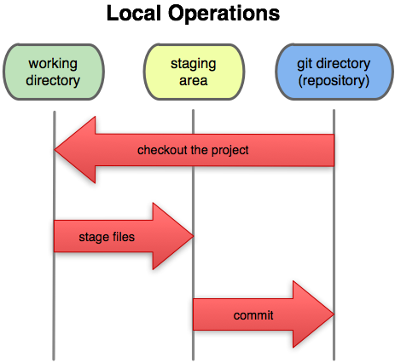
Staging

Slide 9
Staging
When preparing a commit, a file goes through 4 stages:
1) Same as original (the file is unchanged)
2) User editing
3) Staged for commit
(2 and 3 can be repeated many times, the last staged version is committed)
4) Committed.
git add stages a file for commit, or adds a new file to the version control system.
Notes:
The git add command moves changes from the working directory to the Git staging area. The staging area is where you prepare a snapshot of a set of changes before committing them to the official history

Slide 10
Setup
Git installation and check:
https://git-scm.com
git –-version
Config git installation (register yourself):
git config -–global user.name [name]
git config -–global user.email [email]
Notes:
In order to track each user that make changes

Slide 11
Setting up a local repository
Create a new folder and navigate to the folder
Eg. Create a simple html file
git init
Notes:
Repository: Collection of commits, branches, and tags (named commits).
Can be local or remote (ex. Github).
Can have different branches
branches can have a different commit history from the local version

Slide 12
Git Demo
Navigate to the folder of project
Make some change of the file
git status
git add –A
git commit –m “Message”
Some intended/accidental change or deletion
git checkout -- .
Notes:
Git stores data in a hidden system folder on your hard drive repository (locally)

Slide 13
git status
tell you what branch you are on
> git status
# On branch master
# nothing to commit (working dir. clean)
show you how your working directory has changed since your last commit

Slide 14
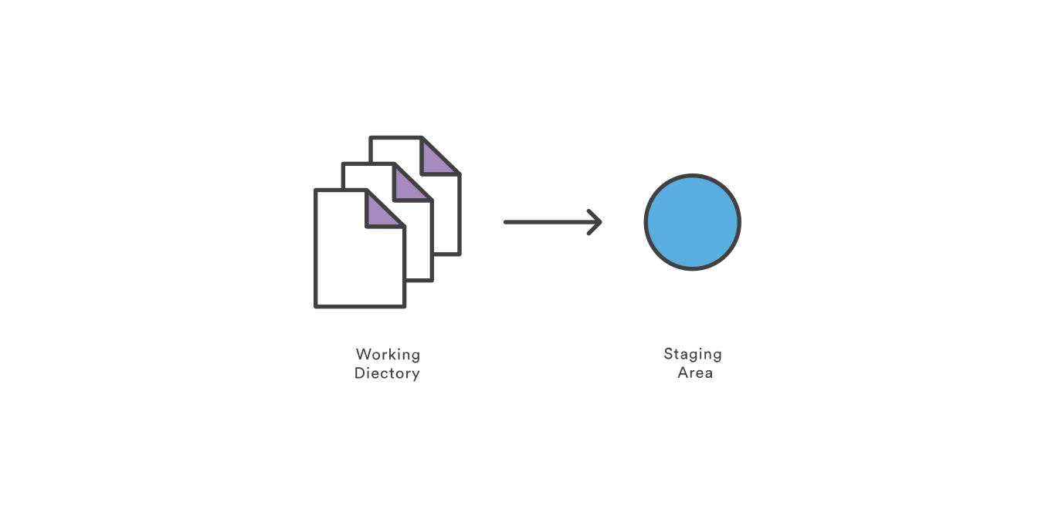
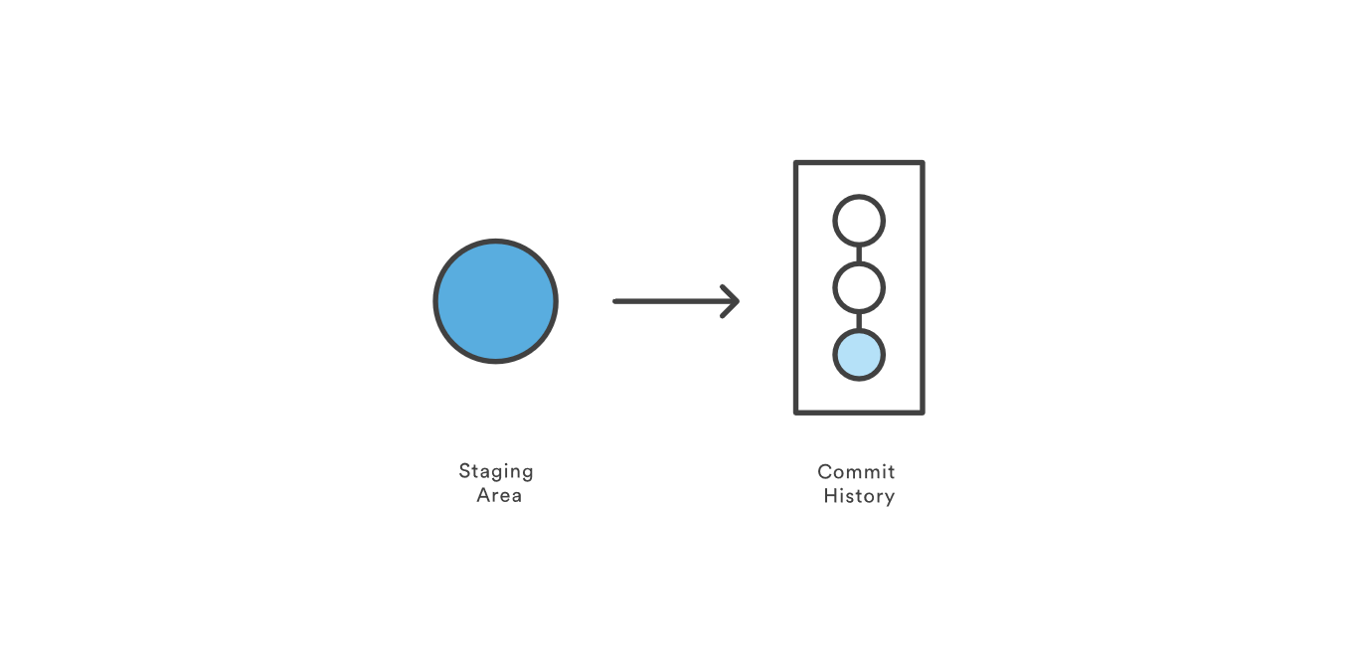
Saving Changes
git add
git commit
Notes:
The git add command adds a change in the working directory to the staging area. However, git add doesn't really affect the repository in any significant way—changes are not actually recorded until you run git commit.
Working directory - The branch that is currently checked out.
Commit - A snapshot of source code & other files for a project

Slide 15
Making The Commit
git commit –m “Message about the changes”
git commit
Will open up an editor* to let you write a commit message describing what you changed. Commit is only made if the message is not empty.

Slide 16
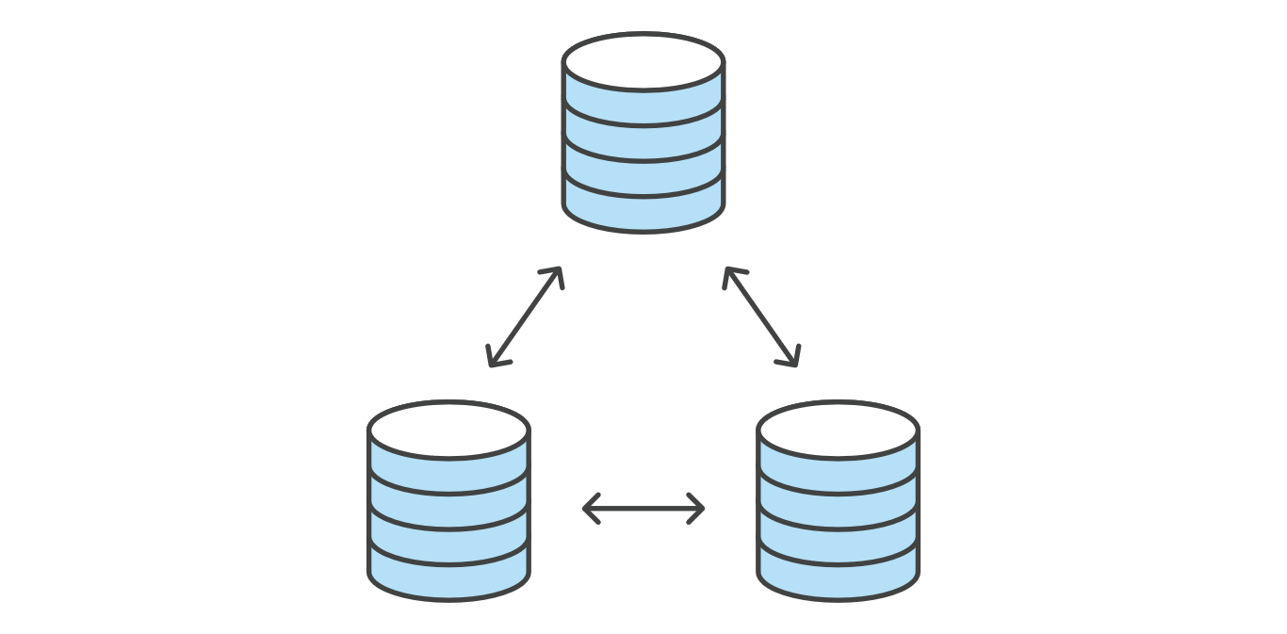
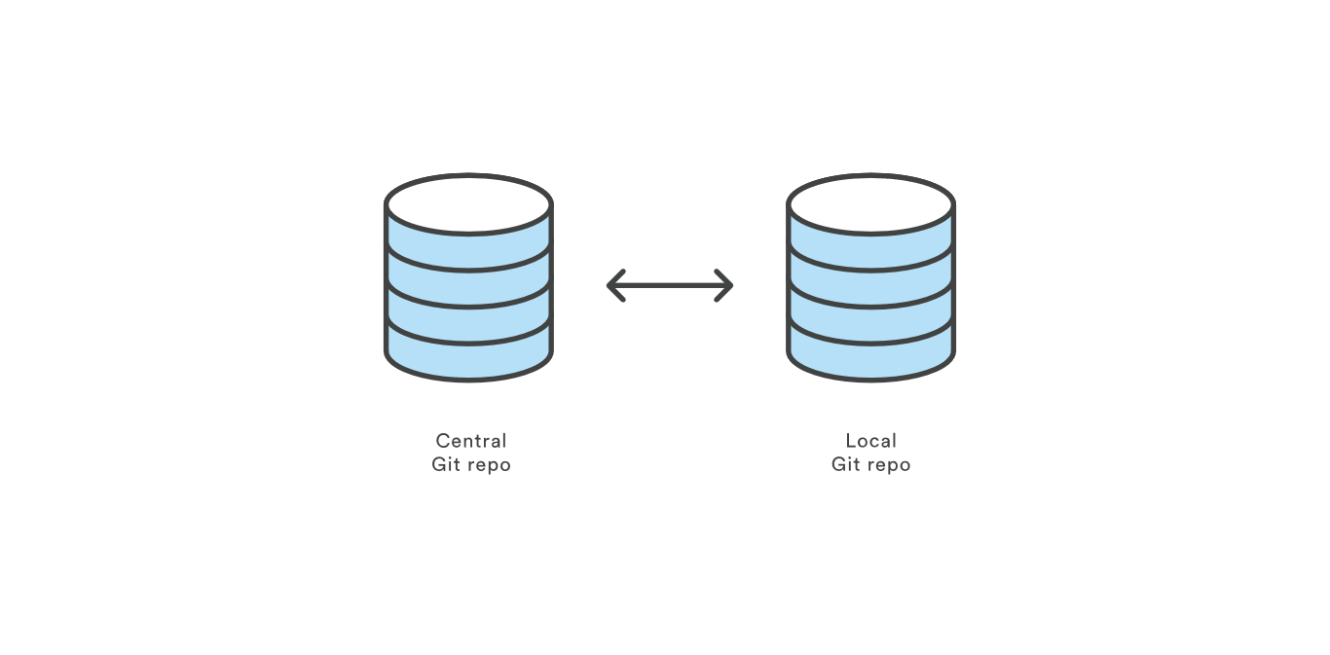
Git Repo Hosting:
Notes:
Information only in your hard drive (hidden folder in your repo)
Computer is dead, only you can log in your computer
Communicate with remote repo
Collaboration with each developer: own entire copy of the repo, its local history and branch structure
Connection with other by pushing and pulling

Slide 17
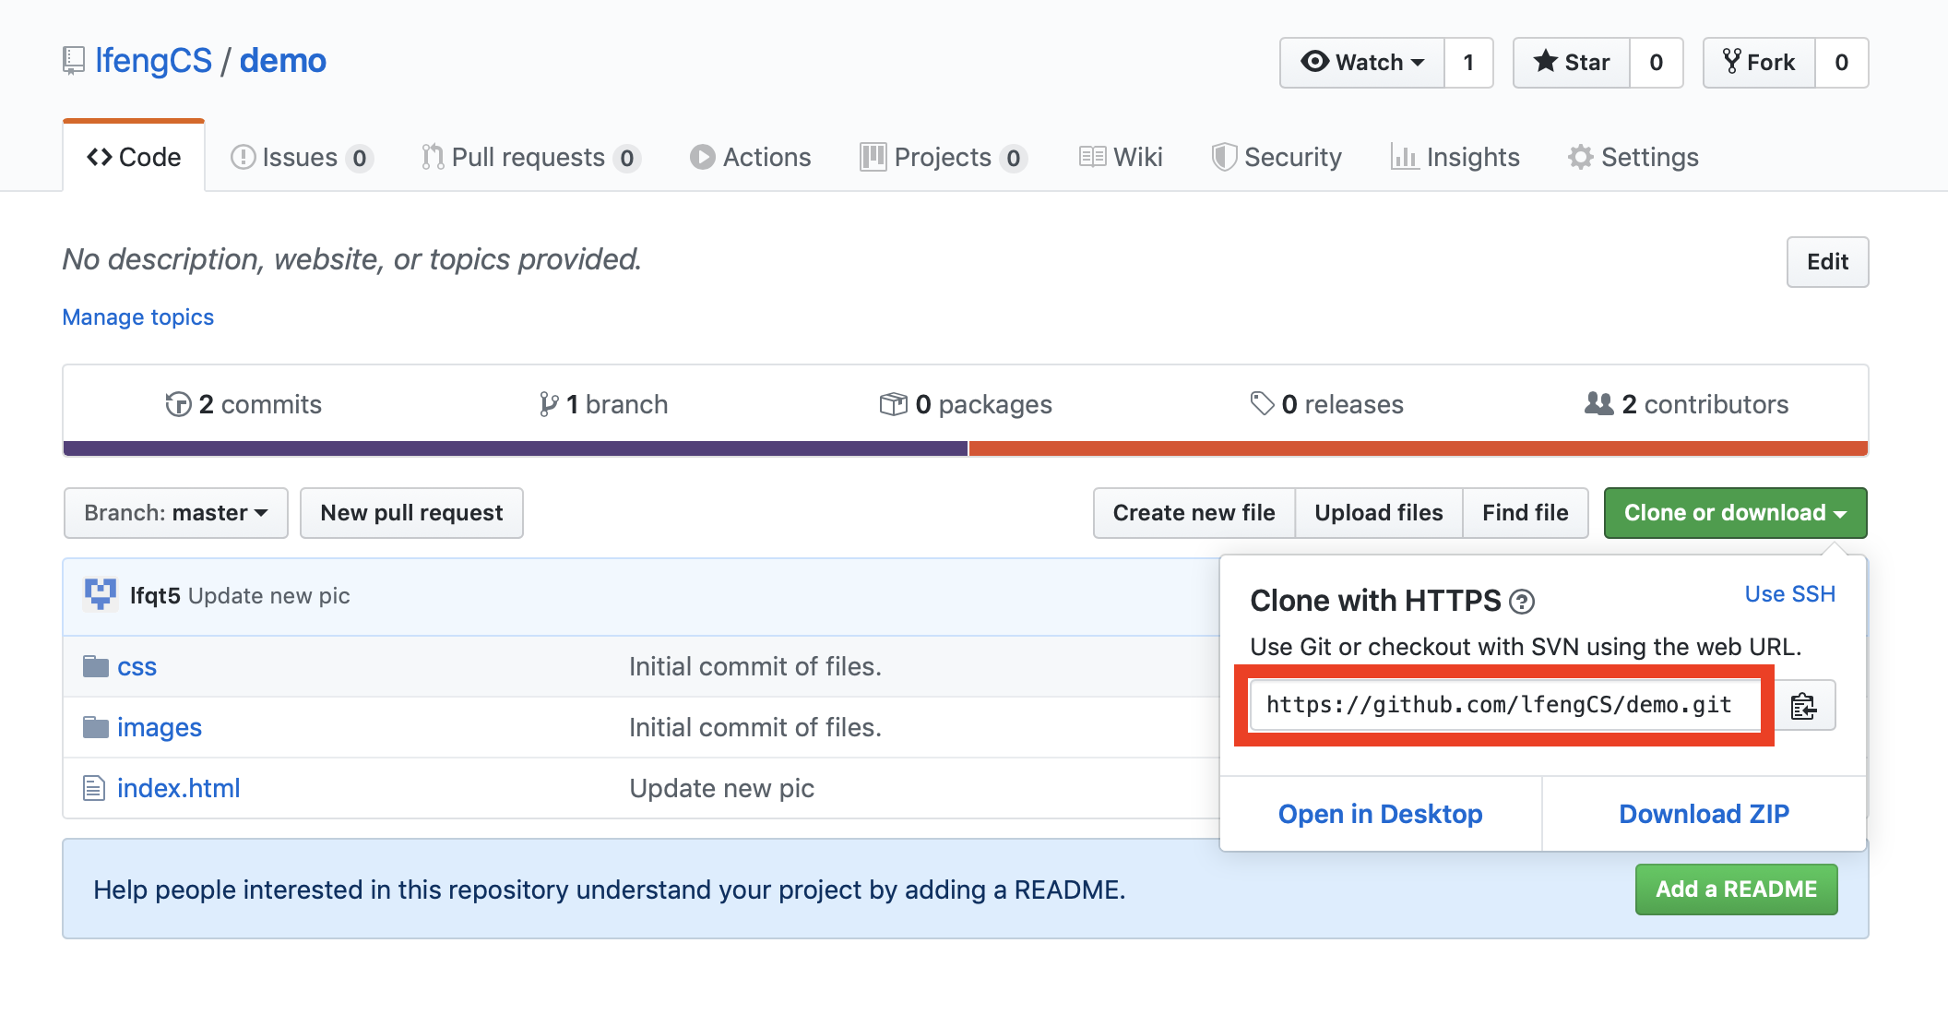
Clone the remote repository to your machine
git clone https://github.com/lfengCS/demo.git

Slide 18
GitHub Hands-on
Create a GitHub account
https://github.com
Free account
Create a new repo on github by creating a name
Push your repo on local computer to remote server

Slide 19
git push
Share your local commits with the rest of the team
Transfer commits from your local repository to a remote repo.
git push origin master
Notes:
Publish your local changes to a central repository
Remotes/Origin - Remote sites (ex. Github) that store branches. Origin is the default name for the first remote site.

Slide 20
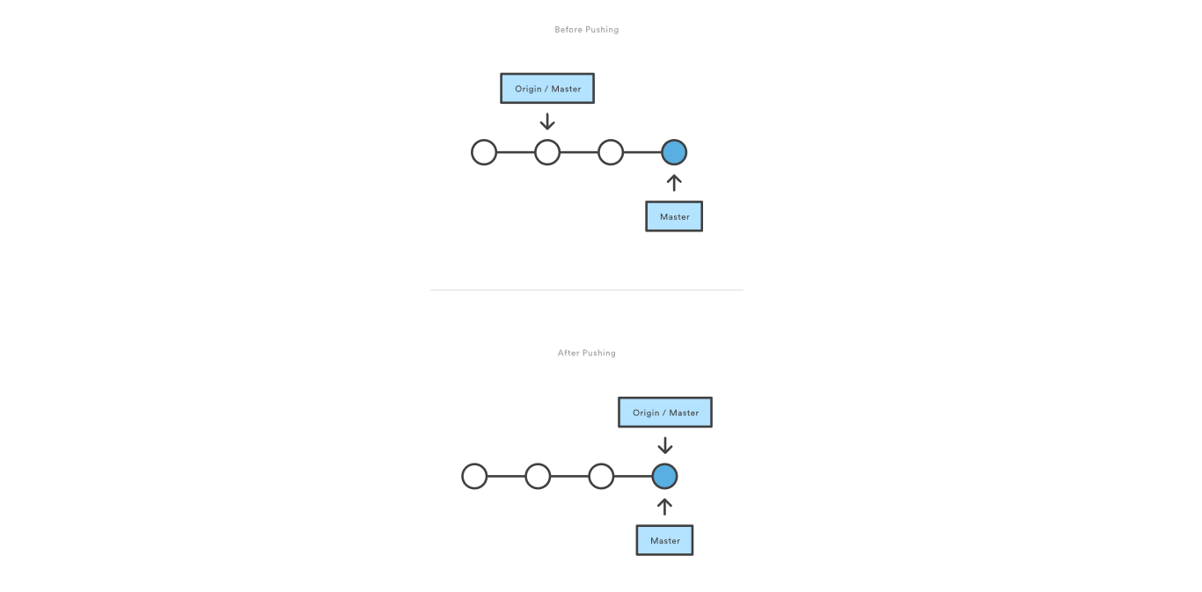
git push
Notes:
Git prevents you from overwriting the central repository’s history by refusing push requests when they result in a non-fast-forward merge.
If the remote history has diverged from your history, you need to pull the remote branch and merge it into your local one, then try pushing again.

Slide 21
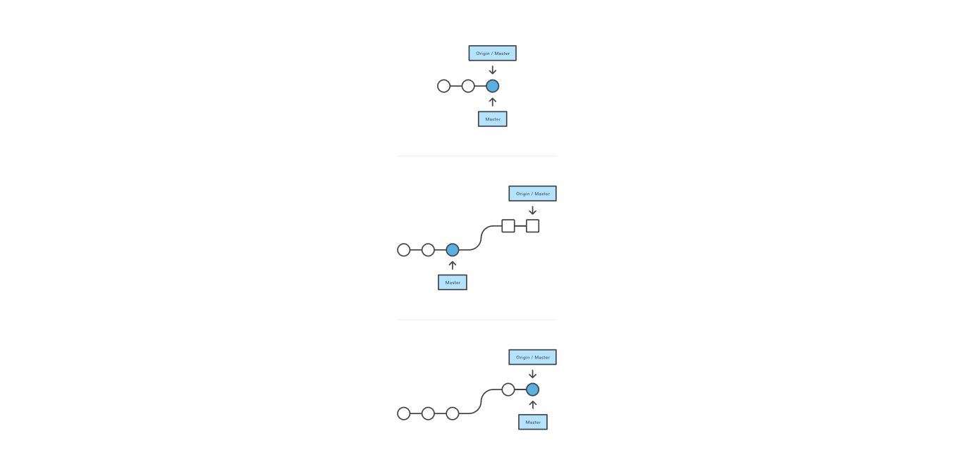
git pull
One single command to merge upstream changes into your local repository

Slide 22
Develop Your Feature
When starting a new feature, you probably want to create a new branch.
Use your favorite editor, and create your feature.
You can make commits to take snapshots of your work as you make changes (always a good idea!)
Notes:
Branch - A path of development. Describes a path of commits.
Commit - A snapshot of source code & other files for a project

Slide 23
Using branches
git branch
git checkout
git merge

Slide 24
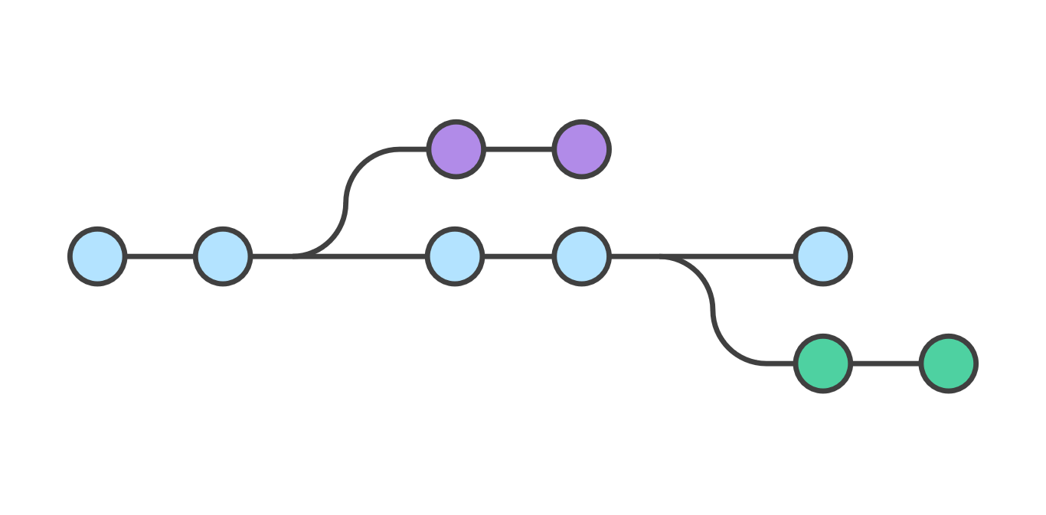
Branches
Development master vs. branches
Creating branch is cheap!
switch among branches: checkout
Separate commit histories per branch
Merge branch back into master
...or with pushing branch changes
Most branches eventually die
branch per feature
Notes:
Branch - A path of development. Describes a path of commits.
Master: The main branch of the project
HEAD - The most recent commit of a branch

Slide 25
Create A New Branch For Your Feature
create a new branch
> git branch newBranchName
switch to the new branch
> git checkout newBranchName
Or: create and checkout to the new branch.
> git checkout -b newBranchName

Slide 26
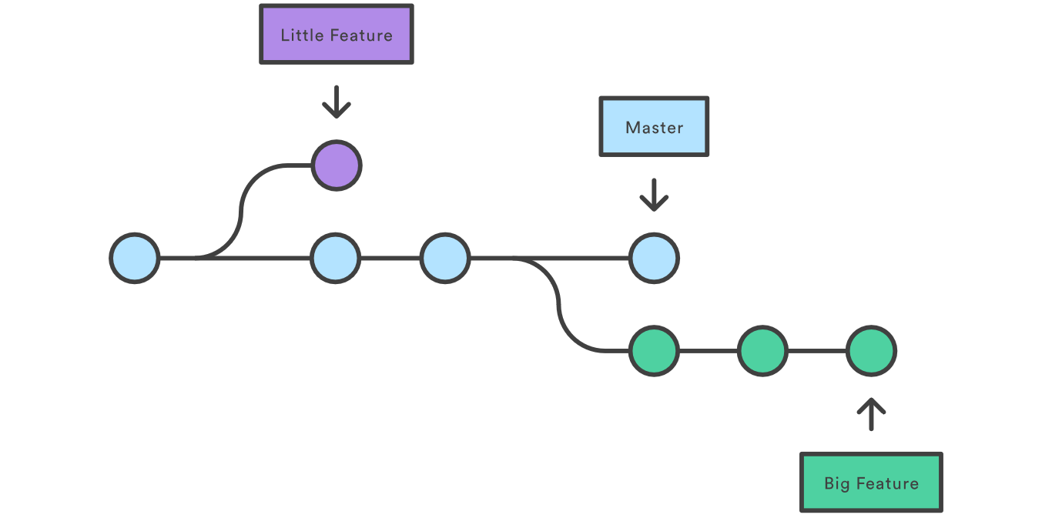
Create branches
Notes:
This makes sure that unstable code is never committed to the main code base, and it gives you the chance to clean up your feature’s history before merging it into the main branch.

Slide 27
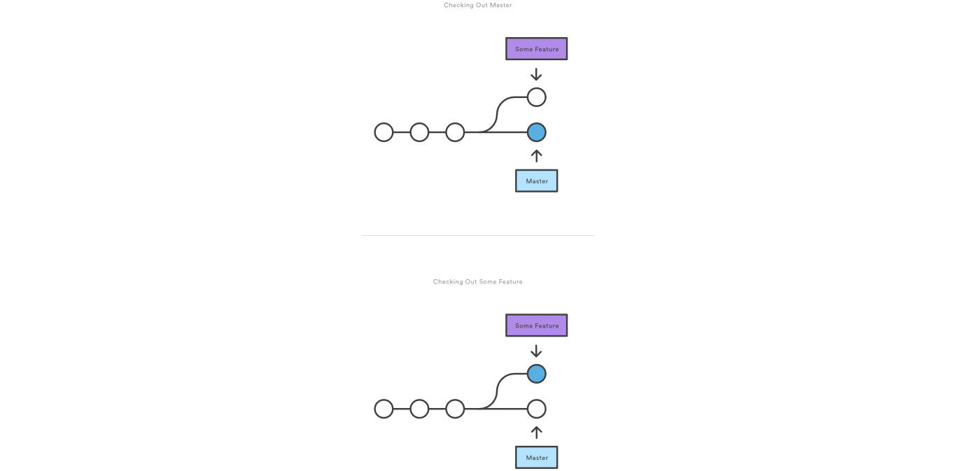
Checkout Branch
Notes:
You can work on multiple features in a single repository by switching between them with git checkout.

Slide 28
git merge
Putting a forked history back together again
Merge to the current branch
The target branch will be completed unaffected
Serval distinct algorithms to merge
Notes:
lets you take the independent lines of development created by git branch and integrate them into a single branch.

Slide 29
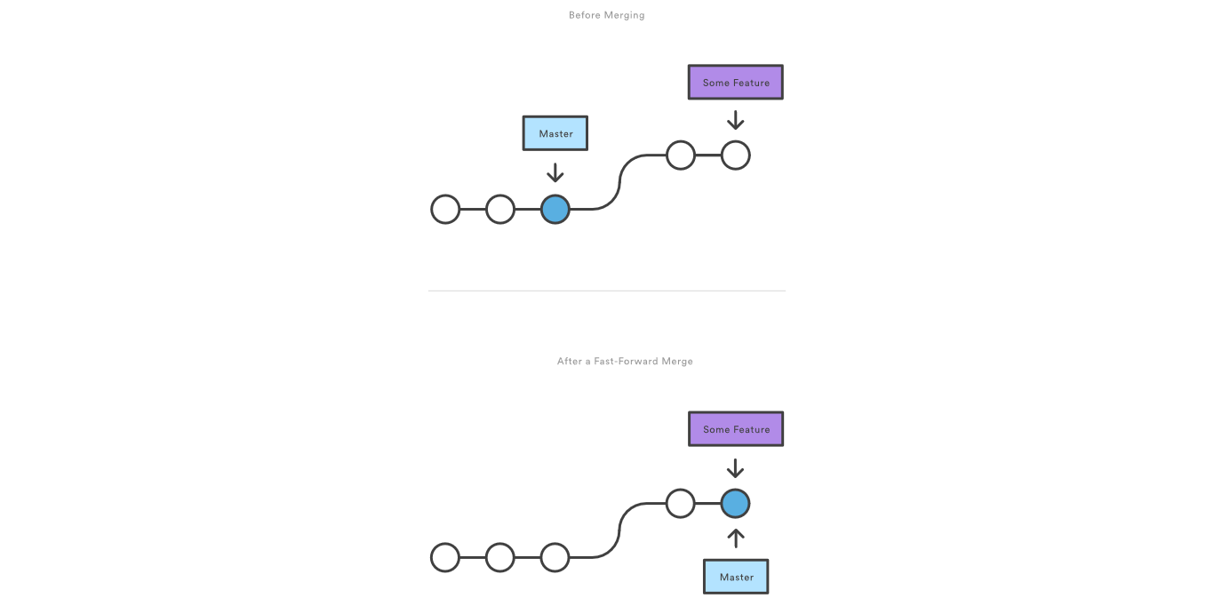
A Fast-Forward Merge
Notes:
when there is a linear path from the current branch tip to the target branch

Slide 30
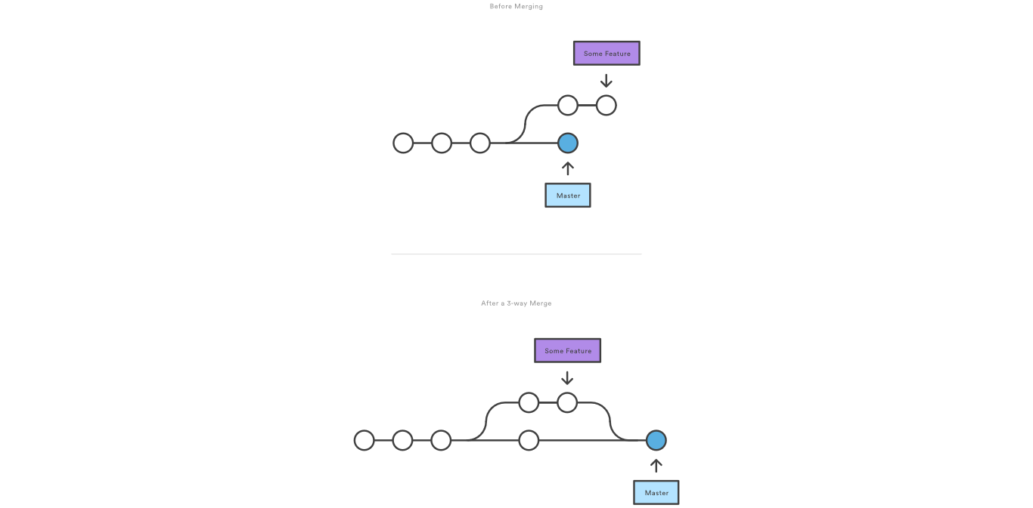
3-way merge
Notes:
if the branches have diverged

Slide 31
Merging Bug-fixes
Combine your development branch with master.
Switch Back To Your Development Branch:
> git checkout feature
Then, merge in master
> git merge master
If master hasn't changed, nothing bad should happen here. If it has, you might get merge conflicts
Notes:
Merge the master branch into the feature branch

Slide 32
Resolving Conflicts
> git status
Will list files with merge conflicts. You should open them and look for the conflicting section. They tend to look like this:
>>>>>>>>>>>>> HEAD >>>>>>>>>>>>
some code lines;
some code lines;
================================
some different code lines;
some different code lines;
<<<<<<<<<<<<< abd31f <<<<<<<<<<<<<
These happen when there are changes in both branches that occur "concurrently"

Slide 33
Conflict Resolution
You should examine each of these, pick one of the two sections (or combine them) sections and remove the conflict section markers.
Finally
git add <file>
Marks the conflict as resolved.
git commit

Slide 34
Commands
git checkout
Changes the working directory to a new branch
git commit
Makes a commit
git branch
creates / lists / deletes branches
git push
Copies local changes to the remote repository.
git pull
Copies remote changes to the local repository.

Slide 35
Commands
git fetch
Determines the remote changes. Like pull, but doesn’t copy the changes.
git status
Reminds you what’s going on
git merge
Combines one branch into another.

Slide 36
Acknowledgement
These slides contain material developed and copyright by:
https://www.atlassian.com/git/tutorials/

